Slide 1



GenAI Knowledge Management
Unlocking the Secrets of Knowledge Management
📚 8500 Existing Articles (That's a lot of knowledge!)
🛠️ 1 Hour/Article Effort for Review and Correction (We've got work to do!)
⏳ 8500 Hours Total Effort for Correction and Review (Time is of the essence!)
⏰ 5 Years Needed for Reviewing Existing KM Database (1 FTE)
⌛ 5950 Hours Can Be Saved (Saving you precious time!)
📆 915 Working Days Can Be Saved (Time flies when GenAI is at work!)
⏰ 3.66 Years(1FTE) Can Be Saved (Patience is a virtue!)
Crafting Standard Operating Procedures
📈 32 Average no of new SOPs created/month in 2023
⏱️ 2.5 Hours Spent on 1 SOP Creation
🗓️ 80 Hours of manual Effort Required/Month
💼 960 Hours of manual Effort Required/Year
Did you know
🎯 50%-70% Project Goal for Manual Work Reduction (Aim high, achieve higher!)

Slide 2
Generative AI Knowledge Management

Slide 3
Critical to quality(CTQ) drill down tree
Getting us closer to 1 minute resolution goal
Improved End User Satisfaction
Reduced Manual Effort in Creating SOP Articles
Knowledge Base Article Relevance
Search Index Accuracy and Retrieval Speed
TAT to generate SOP/Self-help articles
Time for LLM to generate
and rewrite article context
Faster incident resolution
Fast Response
Fast Response
Fast Processing
SLA
TAT to review the generated article
E2E cycle time
Improved L2 dispatching procedure
Number of SOP/articles per
Opco
# of SOPs and self-help articles successfully reviewed
Standardization
index
Meta tag conversion
Machine learning
To tag, Triage
Feedback comments on published articles
End User
Satisfaction Rating(NPS)
% of accuracy of
Meta Tags
Reporting Metrics
Notes:
NPS – measure user satisfaction level(article accuracy, usefulness etc)
E2E – from article generation to review

Slide 4






Project Charter - Knowledge Management & Co-Pilot Assistant
HEINEKEN - the world's most international brewer. It is the leading developer and marketer of premium beer and cider brands. Led by the Heineken® brand, the Group has a portfolio of more than 300 international, regional, local and specialty beers and ciders.
Currently, our SOPs and articles are manually created and updated, resulting in time-consuming processes that hinder efficient knowledge management and impact the overall speed of issue resolution.
Without implementing this project, we'll remain dependent on manual knowledge management processes, resulting in manual effort, ongoing inefficiencies and delays in resolving issues. Consequently, end users may experience dissatisfaction due to extended response times and a suboptimal support experience.
Business Case
In the past year, it was acknowledged the existence of a high number of procedures and self-help articles(8350).
Articles and procedures lack standardized formatting, containing grammar errors, duplicates, and content inaccuracies leading to lengthy SOP review process, and user dissatisfaction.
Currently the entire KM process is handled manually, generating increased resolution time.
In scope: IT user SOP in Service Now, IT Self-help articles in Service Now. Pilot Opco: GetService Opco, TBD based on onboarding timelines
Out of scope: Opcos not onboarded in Service Now, self help articles and SOPs on non-IT related topics. All other Opcos not in pilot
Problem
Statement
Scope
Goal
Achieve between 50% - 70% manual work reduction and contribute to “1 minute ticket resolution” goal by implementing Azure Cognitive Services, on Knowledge management database.
Project Champion: Tjebbe Jehee
Project Sponsor: Gabriela Popescu
Black Belt Mentor: Larisa Jurita
Project Lead: Emilian Ion
Team Members: Iustin Anei, Marian Ionita, Ciprian Marcu, Maria Daghie, Daniel Ene, Rafal Grodek
Project Team
The estimated Business impact would be approximately:
Approx. 6620 hours of manual work reduction.
Reduce resolution time and contribute to 1 minute resolution goal
Increased agent productivity
Increased user satisfaction and custom analytics insights
Phase | Planned Start date | Planned End date | Actual completion
DEFINE | 1-1o-2023 | 31-10-2023
DIAGNOSE | 01-11-2023 | 30-11-2023
DESIGN | 01-12-2023 | 15-01-2024
DEPLOY | 16-01-2023 | 15-03-2024
Business
Impact
Project Timeline

Slide 5


















COPIS – As Is
C
O
P
I
S
Customer
Outputs
Process
Inputs
Suppliers
Heineken end-users Heineken OpCos Heineken Vendors Central services | End Customer Satisfaction Increased user efficiency Reduce resolution time Improve case coverage and standardization | IT User writes the article and sends it for review Subject Matter Experts review and approves the article Article is published in production Article is reviewed bi-annually If no longer relevant, the article is proposed for retirement Subject Matter Experts review the retirement proposal and approve/reject it. If approved article is being retired and removed from production. | Chats Standard conversations Quality guidelines SOP | Heineken end-users Heineken OpCos

Slide 6
COPIS - To Be
Connecting Generative AI to Business
SOP Articles
Hygiene
Creating new articles
Reviewing published articles
Response Delivered
A
B
C
Reducing the number of existing articles on the same topic
Standardizing template model
LLM to be trained on Share Point Central Team repository database and create Self Help articles and GSD articles with specific language for each intended audience
LLM to be trained to update published articles/ flagged articles based on SME input
Highlighting/Notifying articles to be reviewed to the SME members
Target volume* ~ 5-10%
Target volume* ~ 10-15%
Target volume* ~ 5-6%
Target volume* - target volume for proof of concept, small-scale version before full-deployment

Slide 7



High-Level Process Flow
Is this an article for a New article/SOP or for an existingg article/SOP
Start
Knowledge Base
Service Now Knowledge Base
??
Add all the information to Article Body
New article/SOP
IT user must create a new SOP article
Existing article/SOP
Use Generate Article button to send request to Generative AI
Send Request to LLM server to search for same topic articles
LLM will rewrite the article based on the standard template
Choose from the retrieved list the article that needs to be updated
AI/ML server
Based on the SME input:
LLM will generate a new article as per the desired template
LLM will update the existing articles
IT user will validate the article
End

Slide 8


+
GenAI POC Proposal
November 2023
© 2022 Copyright Genpact. All Rights Reserved.

Slide 9
Gen AI Journey | Scalable implementation plan
Scope
Objectives
Identifying and removing duplicates, update articles/SOP
Update existing articles/SOPs
Create new articles/SOPs using a standard layout
Search retrieval
Current Scope
POC Implementation
Analysis
Analysis
Analysis
Genpact proposes to initiate the exercise with first objective - identifying and removing duplicates, update articles/SOP and implement a POC. During the course of the POC, Genpact will analyze the other three objectives and share a proposal
POC
Develop GenAI assist using static data in Heineken Environment for limited region (one OPCO) and user groups scope to prove that GenAI technology delivers value
8 + 4 Weeks
Notes:
System reliability with leaner G&A cost

Slide 10




Our Understanding | of the Business Challenge | POC | Hygiene
Business Challenge
Genpact Solution Approach
Anticipated Impact
Heineken has self help portal (in Service Now Environment) to provide quick help for employees to deal with general/regular issues
Multiple article to get help on same issue. Confusing users
Multiple Articles increase L2 level escalation
Longer wait and resolution time due to dependency on SME
Identify duplicates though similarity identification algorithms
GenAI virtual assist leveraging Open AI’s Large Language Models (LLMs) based on Heineken’s knowledge base (SMX case history, service manuals, FAQs)
Easy to consume front-end application
Scalable solution that can handle parallel requests and high volumes of data (Not part of POC)
Implementation of a strong governance and monitoring process (Not part of POC)
Unique SOPs for each of the problems
Reduction in L2 escalation
Improved customer satisfaction through a better and unique articles
Multiple Articles/SOPs for same issue and higher L2 escalation
GenAI driven knowledge management will remove duplicates and help creating unique SOPs that will reduce L2 escalations
Reduction in number of SOPs and up to date SOPs available
Success Criteria
Procedures and troubleshooting steps should be presented in a logical, step-by-step manner the ways it is in shared format.
Prevent repetition and ensure conciseness.
The new article should retain all relevant and critical information from the original sources.
The new articles should be clear and readable compared to the original, diverse formats.
The rewritten articles must adhere to the predefined standard template in terms of structure, formatting, and style guidelines.
Notes:
System reliability with leaner G&A cost

Slide 11
Entry & Exit Criteria for POC
Entry Criteria
Article Quantity: The POC will utilize a set of 31 articles.
Source of Articles: All articles originate from OpCO Germany published in Service Now
Accuracy Benchmark: The POC is deemed successful if the articles generated by the solution achieve a minimum accuracy of 75%.
Format and Language Compliance: The generated articles must adhere to the standard format layout and demonstrate correct grammar and language usage.
Content Logic and Structure: The solution must effectively capture and integrate the key paragraphs and information from the merged articles. The logic used in structuring the articles should be coherent and comprehensive.
Handling Non-Similar Topics: In cases where no similar topics are identified, the POC will be considered successful if the solution can rewrite the given article in the standard template layout. This rewritten article should maintain the logical flow and coherence of the original content while ensuring concise and correct language usage.
Inclusion of Visual Elements: The integration of pictures and visual elements will be addressed during the review session by the SME
Exit Criteria
Notes:
System reliability with leaner G&A cost

Slide 12
Proposed Solution
→
Knowledge Articles (KA) along with meta data to be fetched by SME from Service Now and shared for one Opco at a single location (Folder)
Segregation of the documents will be done according to the three plans:
Plan A: Assigning topic by short description.
Plan B: Assigning topics by actual content.
Plan C: Assigning topics using summaries of the documents.
→
→
Similar KA will be identified and shared with SME through a UI for approval/ rejection.
→
SME team will verify the groups of KAs manually after the topics are assigned to the KAs.
Once SME gives sign off, system will merge the similar KAs into single KA and provide SME with below:
Merged KA
Suggested short description
Original KA IDs
→
→
Operations teams suggested that no merging logic can be defined hence it will depend on LLM how it merges (accuracy/quality is not guaranteed)
→
A new user ID to be provided by Service Now team to be used for GenAI created KAs.
→
The KAs will be uploaded (along with retire request for the duplicate KAs) by SME as Draft with suggested Short Description and content. The other mandatory fields will be set to default. The uploaded/retired KA will go through Service Now Knowledge approval workflow.
Note → First and the last steps are considered to be accomplished manually for POC by aligned SME. For MVP these can be automated as in slide 14.
Notes:
System reliability with leaner G&A cost

Slide 13




Proposed Solution Flow for POC (Recommended)
User Interface
Approved Merges
To be Merge file details
Knowledge Articles
(& Metadata)
Fetch for 1 Opco*
Upload to Azure BLOB
Clustering based on
Short Description
Actual Content
Summary of Content
Folder1
Clustering
C2
C3
::::::
C1
Merge files
Input Files (Articles & Metadata files (Doc))
Merge File1,File2….
Folder2
Large Language Models
:::::::
:::::::
Clustering**
New data
(LLM based)
Formatted Merged Files,
Short Description,
Original File details
*** Upload the merged article to Service Now
Retire the original articles in Service Now
Human in loop
* Sample data validation with SNOW team to ensure data integrity
** There is not clear merging logic so will be left on LLM
*** The article uploaded/retired articles will go through ServiceNow Knowledge approval workflow
Notes:
System reliability with leaner G&A cost

Slide 14
Proposed Solution Flow with SNOW Integration
Request SNOW articles based on Opco, Short Description etc.
User Interface
Approved Merges
To be Merge file details
Fetch Articles from SNOW
Knowledge Articles
(& Metadata)
Clustering based on
Short Description
Actual Content
Summary of Content
Folder1
Clustering
C2
C3
::::::
C1
Merge files
Data Transformation Layer
Input Files (Articles & Metadata files (Doc))
**Upload merged article
Retire the original articles
Folder2
Merge File1,File2 ….
Large Language Models
:::::::
:::::::
Clustering*
New data
(LLM based)
Formatted Merged Files,
Short Description,
Original File details
* There is not clear merging logic so will be left on LLM
** The Articles with be uploaded as draft with suggested Short Description and Article content. The other mandatory fields will be set to default. The article uploaded/retired articles will go through SNOW Knowledge approval workflow
Notes:
System reliability with leaner G&A cost

Slide 15
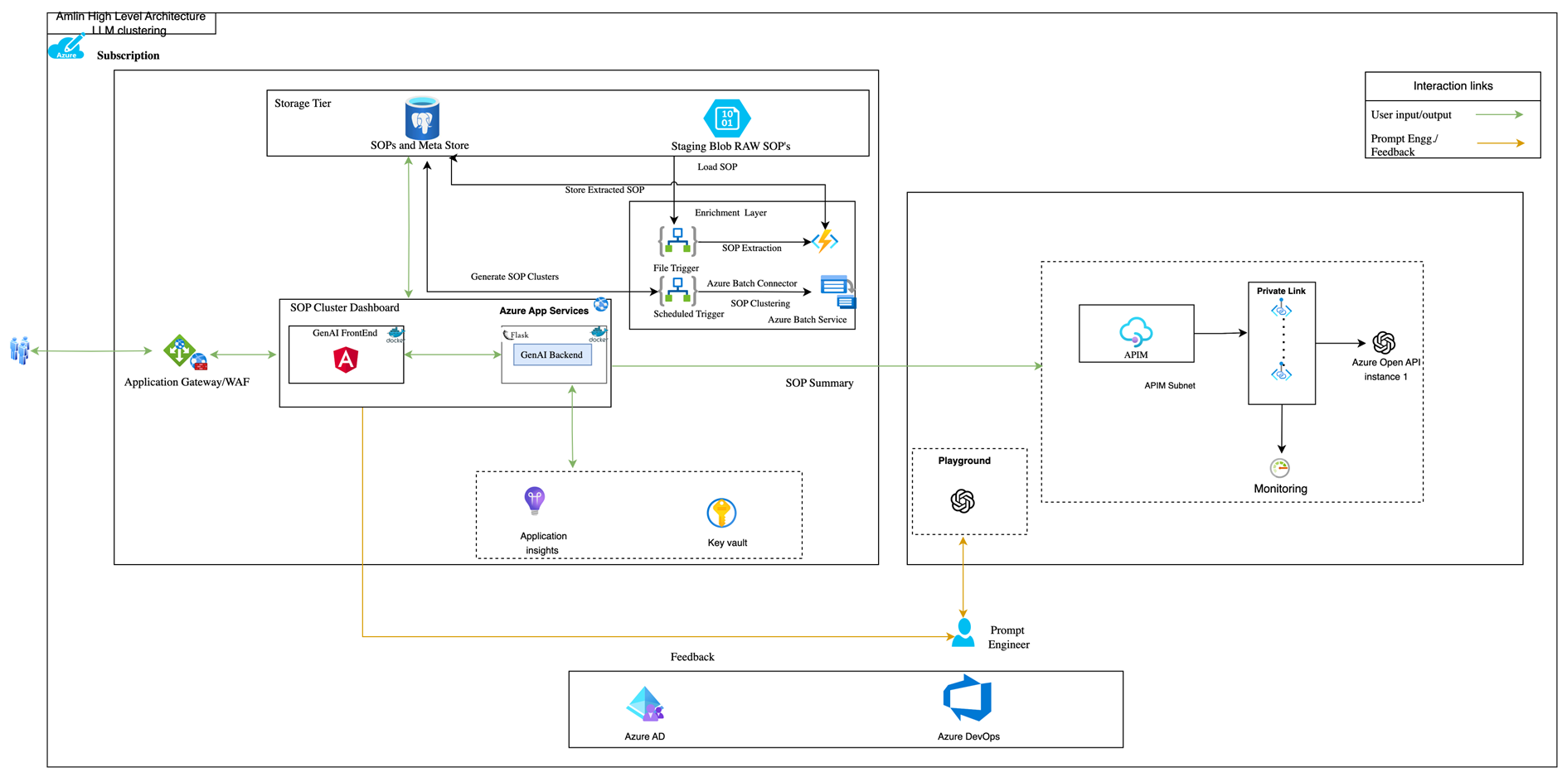
Architecture – Traditional ML based
Execution Plan 1 - Clustering (Similarity Identification) will be done using traditional clustering algorithms
Notes:
System reliability with leaner G&A cost

Slide 16
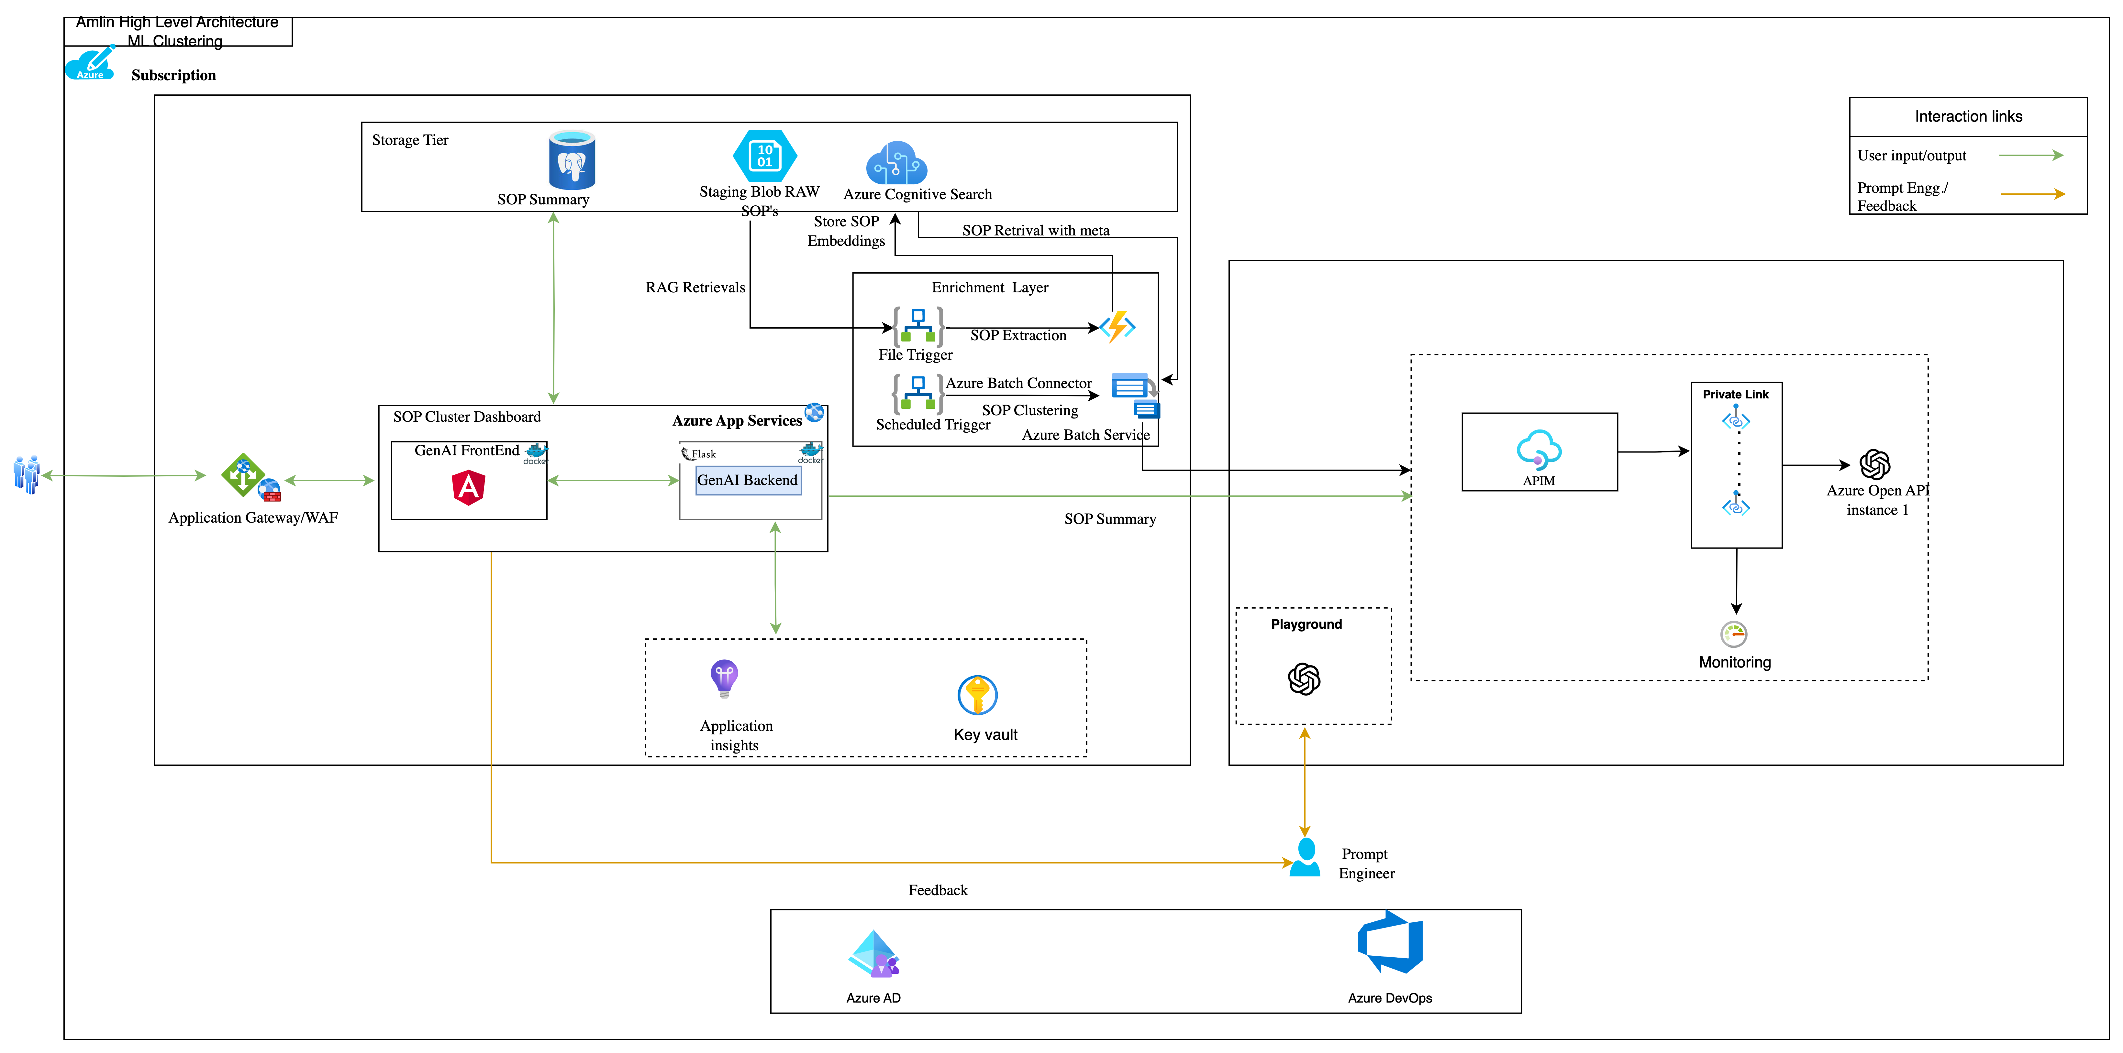
Architecture – LLM based
Execution Plan 2 - Clustering will be done using LLM, it will add some extra LLM service cost
Notes:
System reliability with leaner G&A cost

Slide 17
Design Principles – LLM background Clustering Job
Modularity and Microservices: Break down the solution into smaller, manageable components or microservices. Logic Apps can handle workflow orchestration and integration, while Azure Batch can manage batch processing. This approach facilitates easier maintenance, scaling, and updates.
Event-Driven Architecture: Leverage event triggers within Logic Apps to initiate batch processing tasks in Azure Batch. Events can be sourced from various Azure services (like Azure Storage, Event Grid, Service Bus) or external sources, enabling a decoupled and responsive architecture.
Scalability and Elasticity: Design the solution to scale seamlessly based on workload demands. Azure Batch's auto-scaling capabilities allow dynamically adjusting compute resources. Logic Apps can dynamically adjust workflows based on triggers and load.
Fault Tolerance and Resilience: Implement retry mechanisms, error handling, and fault tolerance in both Logic Apps and Azure Batch tasks. Utilize Azure’s monitoring and alerting systems to detect and address issues promptly.
Security and Compliance: Apply Azure's security features such as Azure Active Directory, encryption, and role-based access control (RBAC) to ensure data security. Comply with industry standards and regulations relevant to your application.
Monitoring and Logging: Implement comprehensive logging and monitoring using Azure Monitor, Application Insights, or other monitoring tools. Track performance metrics, logs, and alerts to gain insights into system behaviour and performance.
Optimization and Cost Efficiency: Optimize resource utilization by using Azure Cost Management tools and strategies. Leverage features like serverless offerings in Logic Apps to minimize idle resources.
Integration and Data Management: Plan for seamless integration with other Azure services or external systems. Use Azure Data Factory or Azure SQL Database for data storage, transformation, and management as required.
Notes:
System reliability with leaner G&A cost

Slide 18
Design Principles – LLM Application
Responsive and Intuitive User Interface: Focus on creating a user-friendly interface that adapts to various screen sizes. Use responsive design principles to ensure accessibility and ease of use.
Asynchronous Data Handling: Design the web app to handle asynchronous data retrieval and updates, aligning with the nature of batch processing. Implement mechanisms to fetch and display results without blocking the user interface.
Data Visualization and Interpretation: Present batch processing results effectively that allow users to easily interpret and analyse the data. Ensure the UI components are interactive and informative.
Security and Access Control: Implement robust security measures to protect data and user access. Utilize Azure Active Directory or other authentication mechanisms to control user access and permissions securely, azure application gateway ,APIM and Vnets/Subnets, key vault to further secure the applications
Performance Optimization: Optimize the web app's performance to handle varying data loads efficiently. Use caching mechanisms where applicable and optimize data fetching and rendering processes.
Scalability and Elasticity: Design the web app to scale seamlessly with increasing user loads or larger data sets. Leverage Azure's scalability features and consider serverless architectures to handle peak demands without downtime.
Integration with Azure Services: Integrate the web app seamlessly with Azure services such as Azure Storage to fetch, process, and display batch processing results. Leverage APIs and SDKs for smooth integration. Deploy to managed container orchestration services like Azure App services
Testing and Continuous Integration/Continuous Deployment (CI/CD): Implement rigorous testing procedures to ensure the web app's functionality, performance, and security. Use CI/CD pipelines to automate deployment and updates, ensuring reliability.
Monitoring and Analytics: Incorporate monitoring tools like Azure Monitor or Application Insights to track the web app's performance, detect issues proactively, and gain insights into user behaviour for continuous improvements.
Notes:
System reliability with leaner G&A cost

Slide 19









Architecture – Data Transformation Layer
Java Micro Service
Read - API
Gateway
Service 1
Service 2
Service 3
Service 4
Draft - API
Gateway
Request
Java
Spring Boot / JPA ORM / Entity Framework
Invoke
Response
Retire - API
Gateway
ServiceNow
User Interface
Data uploaded
Data Transformation
API
Gateway
Data picked by Gen AI Module
- JWT
- CORS
Retrieve Data
BLOB
Data uploaded by Gen AI
Azure Application Services
Notes:
System reliability with leaner G&A cost

Slide 20
Guiding Principles – Data Transformation Layer
The application will not be exposed to the external world as will act as a bridge for the Request Response from the input received via single UI
Loosely coupled, i.e., configurable for the other system to have a seamless interaction/channelization of information
Virtualizing the Application Services by using the Azure Application Services
Utilizing Cloud for designing middle layer Application Services/service façade
Use design to foster scalability, configurability and efficiency
Standardization in ways of working if multiple regions adhering to different working mechanism are place in scope
Variances to be handled prior automation
Gateway Aggregation aggregates requests to multiple individual microservices into a single request, reducing the application run time overhead
Use of Property bags/files for configuration and scalability
Notes:
System reliability with leaner G&A cost

Slide 21
Illustrative | Timelines and Project Plan for POC – Hygiene
POC Deliverables | Stage 0 |  |  | Stage 1 |  |  |  |  | Stage 2 |  | Stage 3
 | (Prep) |  |  | (Build & Test) |  |  |  |  | (UAT & Go-live) |  | Hypercare
Gen AI Assist for R&D Scientists: POC | 1 Week |  |  | 6 Weeks |  |  |  |  | 1 Week |  | 4 Weeks
POC Execution Plan | Prep and Build |  |  |  |  |  |  |  |  | UAT and Go Live | 4 Weeks
Activities | W0 | W1 | W2 | W3 | W4 | W5 | W6 | W7 | W7 | W8 | W9 | W10 | W11 | W12
Project Initiation and Infrastructure Set up
Data Gathering, Understanding and Refine
Design Gen AI Solution Architecture and Sign Offs
Initiate UX design, Create and Finalize Wireframes
Data Pre-processing and Gen AI Pipeline Development
Identification of similar document
SME Review
Iterative Prompt Tuning, Hyperparameter Tuning and Evaluation
Integration of UI and GenAI Backend Pipeline
Optimize the application for efficiency
Unit Testing
Integration Testing
User Acceptance Testing
Soft Go-Live
Hypercare
Notes:
System reliability with leaner G&A cost

Slide 22
Assumptions and Call Outs | POC- Hygiene
The accuracy and performance estimate can be made only after one level of experiments during development.
As there is no clear business logic to define a merging method or a correct SOP, it depends on the capability of LLM
Up to 20 prompts will be used. Count will depend on the complexity of inputs and quality of output
Images (Snapshots) and tables will not be there in inputs data and output, that will be taken care separately by SME
LLMs have showcased partial success in fetching information from tabular content.
Variations in Input data due to different Products, placement or sequence of inputs in text content will have to be assessed during the development stage. This may lead to performance challenges.
Prompt re-engineering and re-deployment won't be automated.
Security posture may have changes based on control specifications, aligned with Heineken’s control compliance requirements.
Proposed Solution may see changes in the tech stack based of further clarity on functional and non-functional requirements, infrastructure along with Legal and Infosec compliance dependencies.
Only the admin will be allowed to upload data from the backend.
DevOps, multi-environment deployments and Infrastructure as code (IaC) will not be included.
A Serverless Embedding Pipeline to load bulk data will not be included
The scalability of the solution needs to be adjusted as per the total and concurrent number of users is out of scope
Non-English Knowledge articles are out of scope
IP of this solution will remain with Genpact though Heineken will be owner of code base
Hypercare support is limited to debugging of code and UI deployment related to any issues with this POC/ POC data
The Service Now JSON format with all response tags will be static in nature with a single format in scope, i.e., will contain all available tags for all relevant documents/artifacts/KAs.
The format for writing back to ServiceNow is static for Drafting the KAs
The APIs from ServiceNow are available for consumption with respect to read, write and retire
There is no Queue system support for POC, & no notification service will be developed as part of this POC
Notes:
System reliability with leaner G&A cost

Slide 23

Pre-requisites and Dependencies | POC - Hygiene
The data (Article and Meta data for one OPCO) should be made available to Genpact prior to the project kick-off.
GPT 4.0 access in azure should be provided from day1.
Requirements for solution and front-end application should be agreed upon prior to project kick-off
High-Level Technology Design should be approved by IT team of client organization for approval before development
Technology Stack as identified must be approved by the client IT, Infosec, Legal and any other teams as needed
Data Transfer and Data Sharing definitions as applicable must be approved in accordance with client’s data audit team.
Access control framework to be approved Client IT/Infosec/Legal team that restricts unauthorized access to the Generative AI system and its associated data with role-based access control
Ops procedures, SLA requirements, and Monitoring procedures will be governed by the Client team as per their standard procedures. These must be made available to the development team if required for development and deployment.
Deployment Checklist should be approved by the Client teams before deployment initiation in Production environments.
Network Design approval must be provided to the development team before development initiation.
Infra set up and user access to be provided by Heineken prior to the project kick-off
Notes:
System reliability with leaner G&A cost

Slide 24
Technical Stack | Skill Requirements POC – Hygiene
Azure Cloud Subscription
App Services
Azure API management
Azure Key vault
Azure Application gateway
Azure Storage Account blob store
Azure Functions
Logic Apps
Azure Batch
Azure Cognitive Search,PosGres SQl
Langchain
Docker
Vnet/Subnets, Private Links ( DMZ approach in a single Vnet)
Azure Application Insights
Azure Open AI
Angular
Java
Notes:
System reliability with leaner G&A cost

Slide 25
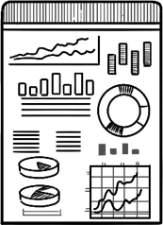
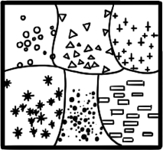
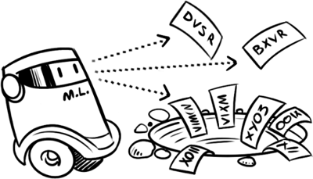








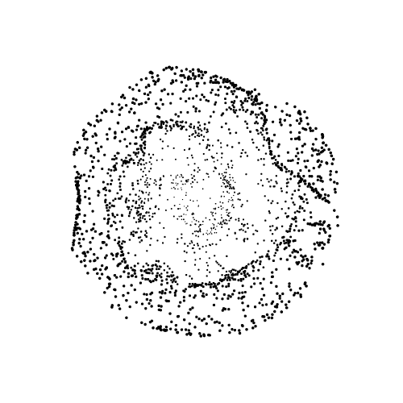
Media Monitoring of Lifesciences & Healthcare Products
BUSINESS CHALLENGE
Previously, media analysts of the world’s largest healthcare organizations generated daily reports on the media coverage of products by manually reading, analyzing and interpreting various information sources like news articles, social media posts, consumer comments and more. Such resource extensive process prohibited the organization to timely augment it’s marketing strategies.
DEVELOPED SOLUTION
Assimilated the information from various information channels from 10+ LATAM regions
Extracted metadata from the articles, such as – title, date, location, author and many more, to better understand the context of the articles
Revolutionized media monitoring with cutting-edge NLP solution powered by ChatGPT, enabling –
Automatic categorization
Article summarization
Sentiment analysis
Focused on tailoring prompts configured for determining the following elements from media articles –
Prominence
Tone
Augmented Data Pre-processing
ChatGPT based Solution
Focused Prompt Engineering
BUSINESS IMPACT
Enabled organizations to penetrate specific regions by equipping with data-driven insights on market perception of products & reduced 90% of efforts expended by analysts previously.
Streamlined integration of Generative AI powered Media Monitoring solution with existing workflows and systems with high degree of configurability and customization.
Technology Stack
Industry
Service Line
Pillars
Lifesciences & Healthcare
Sales & Commercial
Generative AI
Machine Learning
NLP /
Text Mining
GPT-3
Notes:
System reliability with leaner G&A cost

Slide 26

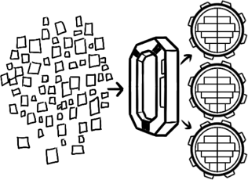




Financial Reporting Assistant for Investment Analysts
BUSINESS CHALLENGE
Financial analysts of investment banks create financial reports for their customers with buy/sell/hold recommendations about investments. They generate this report using KPIs from quarterly/annual results of companies and pertinent market intelligence. Analysts are challenged to triangulate these information and generate reports within a narrow window of ~30 minutes before share market opens.
DEVELOPED SOLUTION
Fetched historical data & read the financial KPIs from latest quarterly/annual filings. Compared the latest KPIs with estimates
Allowed the user to input market changes/events that could affect the financial performance of the company
Leveraged LLM model to read the document/report in context of financial domain for –
Key field extraction from database
Comparison with estimates
Summarized report generation
Tool has an easy-to-consume UI that provides a very smooth and simple to use interface.
Allowed user to select the edit/save the report
User can add domain/market intelligence in form of comments to justify the gap from expectations
Data Assimilation
GPT-3 (Davinci) powered Solution
Market Intelligence Embedment
Domain/Market Intelligence Incorporation
BUSINESS IMPACT
Saves reading effort of an analyst.
Saves the time of creating the report and provides additional time to analyst to focus more on analyzing the numbers and making the recommendations
Technology Stack
Industry
Service Line
Pillars
Banking & Capital Markets
F&A Analytics
Generative AI
Machine Learning
NLP /
Text Mining
GPT-3
Notes:
System reliability with leaner G&A cost

Slide 27







Reports Summarization for Financial Advisors
BUSINESS CHALLENGE
The financial service and investment advisory organizations have been hamstrung with resource extensive and time consuming approach in extracting meaningful and actionable insights from verbose 10K annual reports comprising strategic, financial, operational and tactical details across various formats like images, tables, textual paragraphs and more.
DEVELOPED SOLUTION
Aggregated the verbose and versatile PDFs and performed -
Text Extraction & Pre-processing
Text Segmentation
Embedding generation & Vector Database Storage
Provided carefully crafted prompts across multiple stages that utilized the pre-trained GPT-3 (Davinci) language model to perform
Keyword-based information extraction based on strategic/financial/operational/tactical sections
Utilized Lang Chain framework to develop the entire workflow to extract insights on company’s overview in a specific order –
Business
Segment
Financial
Augmented Data Pre-processing
Custom LLM based Solution
Lang Chain powered Engineering
Cognitive Data Corpus
Sections
Structured responses
BUSINESS IMPACT
Enhanced productivity & efficiency of analysts by equipping them with the ability to derive reliable and accurate data-driven insights based on their task objectives.
Enabled organizations to improve their bottom line through a cost-effective solution that does not require expensive Data Analytics and Business Intelligence specific tools & services.
Technology Stack
Industry
Service Line
Pillars
Banking & Capital Markets
F&A Analytics
Generative AI
Machine Learning
NLP /
Text Mining
GPT-3
Notes:
System reliability with leaner G&A cost

Slide 28

Commercials
Team Composition
Project Manager
Domain SME
Full Stack Architect
Data Scientists
ML Engineers
AI Application Engineers
Quality Assurance Testers
Developers
Total Charges for POC - GenAI
Implementation & Hypercare
Ongoing Support (Monthly)
Total Charges for POC – Data Transformation Layer
Implementation & Hypercare
Ongoing Support (Monthly)
Notes:
System reliability with leaner G&A cost

Slide 29

+
Proost!
…and thank you
© 2022 Copyright Genpact. All Rights Reserved.

Slide 30

Engineering Side to be update by Megha/Sushant
Proposed Solution Flow
Engineering team
Data Science
Reference Table (showed only for single folder)
Folder1 | Service now key | Filename/Short Description | Topic# | Topic Name | Approval
File1 | *123** | Ethernet | 1 | Network | Yes
File1 | *456** | VPN | 1 | Network | Yes
File2 | *245** | Ethernet | 2 | Network | No
File2 | *985** | VPN | 2 | Network | No
: | : | : | : | : | :
Clustering based on
Short Description
Actual Content
Summary of Content
Folder1
Clustering
C2
C3
::::::
C1
Raw data
fetch
Raw data
Service Now
Input Files (Pdf, Doc )
Folder2
Grouping
Business logic
Clustering
Large Language Models
Approval
:::::::
:::::::
Populate Topic name
New data
Yes
Merged Files
Large Language Models
Merge File1,File2 ….
There is not clear merging logic so will be left on LLM

Slide 31
Engineering efforts to be update by Megha/Sushant
Commercials
Heineken - POC
Development - 8 weeks
Sl No | Location | Band | # of Resource | Utilization | Focus
1 | Offshore | 3 | 1 | 0.5 | Lead Data Scientist / Project Lead
2 | Offshore | 4C | 1 | 1 | Sr. Data Scientist
3 | Offshore | 4B | 1 | 1 | Data Scientist
5 | Offshore | 3 | 1 | 1 | Full Stack Architect
6 | Offshore | 4D | 1 | 0.5 | Project Manager
7 | Offshore | 4D | 1 | 1 | AI App Designer
8 | Offshore | 4D | 1 | 1 | Senior ML Engineer
9 | Offshore | 4C | 1 | 1 | ML Engineer
10 | Offshore | 4B | 1 | 1 | QA/Testers
Hypercare - 4 weeks
Sl No | Location | Band | # of Resource | Utilization | Focus
1 | Offshore | 4C | 1 | 0.5 | Senior Data Scientist
2 | Offshore | 4D | 1 | 0.5 | AI App Designer
3 | Offshore | 4C | 1 | 0.5 | ML Engineer

Slide 32
Proposed Solution Flow for POC (Recommended)
reword
Document (along with meta data ) will be shared at one location (Folder/Database)*
Segregation of the documents will be done according the three plans
Plan A: Assigning topic by short description.
Plan B: Assigning topics by actual content.
Plan C: Assigning topics using summaries of the documents.
Similar documents will be identified and shared to SME
SME team will verify the groups of documents manually after the topics are assigned to the documents
Once SME gives sign off, all similar documents will be merged in to one document.
Operations teams suggested that no merging logic can be defined hence it will depend on LLM how it merges (accuracy/quality is not guaranteed)
Merged document** will be share for SME review
User Interface
Approved Merges
To be Merge file details
To be Merge file details
Fetch for 1 Opco*
(manual)
Upload to Azure BLOB (manual)
Knowledge Articles
(& Metadata)
Clustering based on
Short Description
Actual Content
Summary of Content
Folder1
Clustering
C2
C3
::::::
C1
Merge files
Input Files (Articles & Metadata files (Doc))
Merge File1,File2 ….
Folder2
Merge File1,File2 ….
Large Language Models
:::::::
:::::::
Clustering**
New data
(LLM based)
Formatted Merged Files,
Short Description,
Original File details
Upload the merged article to SNOW*** (manual)
Retire the original articles in SNOW (manual)
* Sample data validation with SNOW team to ensure data integrity
** There is not clear merging logic so will be left on LLM
*** The article will be uploaded to SNOW manually and will go through SNOW Knowledge approval process

